Slide 1
Workshop: Natural History of Spontaneous Seizures Following Acute Intoxication with DFP
Data generated during Year 1 of the Center.
Males & Females
5 Brain Regions
5 Time points
  1, 3, 7, 14, 28 days post DFP intoxication
    3 Domains
      Neuroinflammation
      Blood Brain Barrier
      Electrophysiology / EEG
Long-term SRS and Behavioral Outcomes
  Subsets @ 28 days, 7 weeks, 11 weeks
Totaling ~1000 Statistical Comparisons

Slide 2












Brain Areas in the Natural History Data
Based on the Year 1 milestones
  Canonical Regions of Brain Injury following OP Intoxication
Representative Outlines
  Exact field of view and bregma varies by outcome measure
Hippocampus
Thalamus
Amygdala
Piriform Cortex
Somatosensory Cortex*
Entorhinal Cortex*
*subsets of metrics

Slide 3
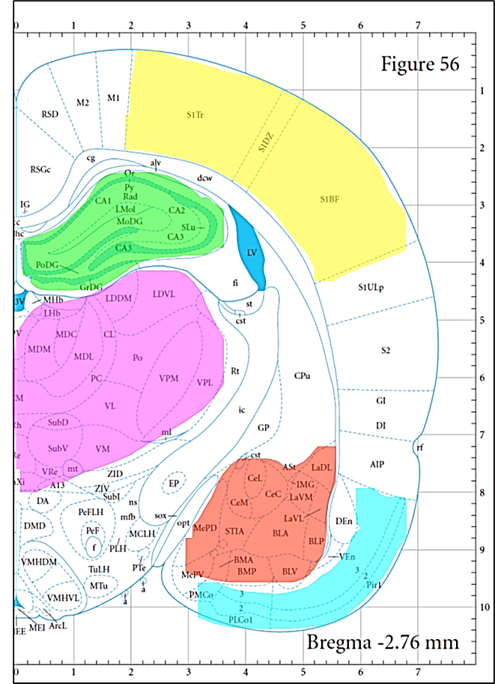
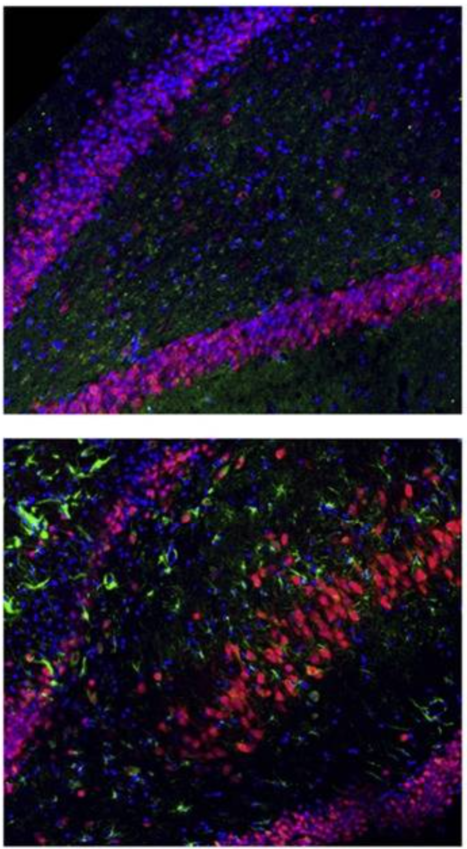
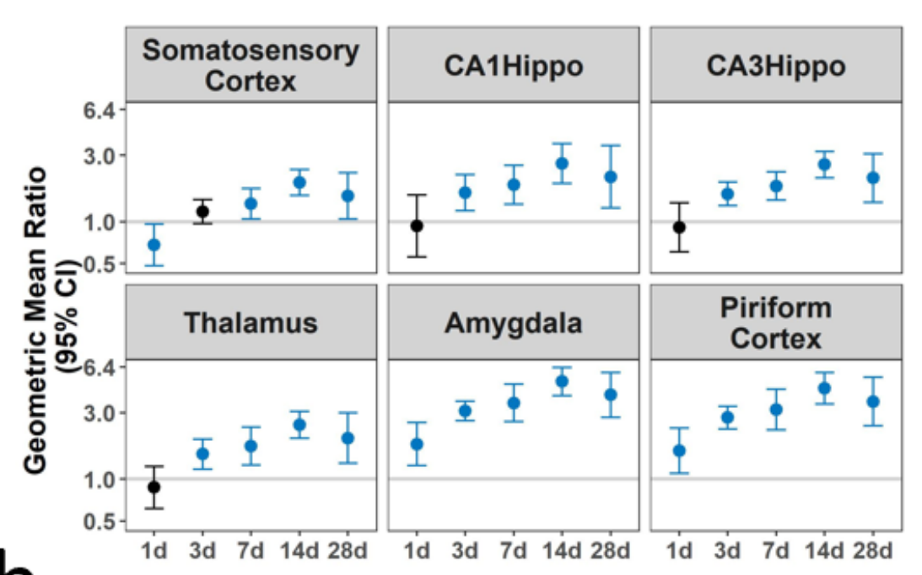
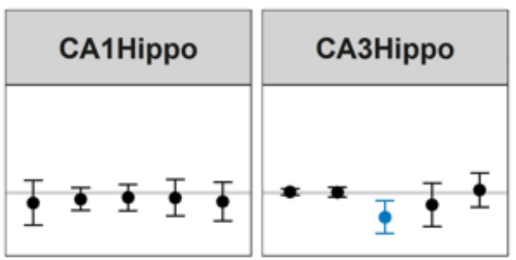
Generation of Natural History Summary Data
Region =
Hippocampus
Outcome Class (Project) = Neuroinflammation (P1)
Metric (DFP vs VEH)=
iNOS+ Cell Density
Longitudinal Summary
Males
Endpoint | Sex | 1(d) | 3 | 7 | 14 | 28
iNOS+ Cell Density | Male | 0 | ++ | ++ | ++ | ++
 | Female | 0 | 0 | -- | 0 | 0
For Tabulation
Purposes:
Females
++ | Significant Increase
+ | Upward Trend
0 | No Effect
- | Downward Trend
-- | Significant Decrease
2
1
0
-1
-2

Slide 4


Examples of questions that might be addressed using this data set
Which outcomes occur prior to onset of SRS or cognitive impairments?
Which outcomes increase in magnitude with increasing SRS frequency or severity?
Are any outcomes predictive of other outcomes?
Is SRS severity/frequency correlated with worse cognitive outcomes?
Does the timing of any of these outcomes provide any information on what to target for prevention and when to best pharmacologically intervene?
Can we learn anything about brain regions that are the most vulnerable? Most associated with SRS or cognitive impairment?
Are the same interventions effective when provided a) prior to development of SRS, b) within days of first detected seizure or c) perhaps weeks after the initial seizure?

Slide 5
Which, if any, variables co-vary? For example, does variance in seizure burden explain the variance in inflammation or behavior? In other words, do the animals with the most seizures (or perhaps most severe seizures as measured by racine scale and seizure duration) have the most inflammation?
Will treatment efficacy vary based on seizure burden?
Are there biomarkers (blood, neuroimaging, electrophysiology, behavior) that predict which animals are at risk for SUDEP?
Given the variance observed to date, can we determine the necessary sample sizes to build a more comprehensive model rather than compare individual outcome measures? If not, how many more samples do we need simply to make that estimate?

Slide 6
Overview of the Complete Dataset
 | 1 (d) | 3 (d) | 7 (d) | 14 (d) | 21 (d) | 28 (d) | 6 weeks | 7 weeks | 11 weeks | 12 weeks
Neuroinflammation | 125 | 140 | 104 | 100 |  | 122
BBB | 74 | 56 | 86 | 58 |  | 57
Electrophysology | 12 | 10 | 10 | 8 | 8
Seizure | 0 | 0 | 8 | 8 | 8 |  |  | 8 |  | 8
Behavior |  |  |  |  |  |  | 10 |  | 4
(Absolute Value)
broad brush-stroke summaries
  Consolidation of ~200 outcome measure
At any time, or for any question:
  Compare Sexes, Regions, Timepoints
  View individual outcome measures
2 | Significant Increase
1 | Upward Trend
0 | No Effect
- | Downward Trend
-2 | Significant Decrease

Slide 7
Summary of SRS / EEG
Outcome Class | Endpoint | Animal Sex | 1 Day | 3 Days | 7 Days | 14 Days | 21 Days | 7 wks | 11 wks
Electrophysiology | Inter-Ictal Spikes | Female | 2 | 2 | 2 | 2 | 2
 |  | Male | 2 | 2 | 2 | 2 | 2
 | Theta Power* | Female | 2 | 2 | 2 | 0 | 0
 |  | Male | 2 | 0 | 0 | 0 | 0
 | Theta:Delta* | Female | 2 | 2 | 2 | 2 | 2
 |  | Male | 2 | 2 | 2 | 2 | 2
Seizure | Duration | Female | 0 | 0 | 2 | 2 | 2 | 2 | 2
 |  | Male | 0 | 0 | 2 | 2 | 2 | 2 | 2
 | Frequency | Female | 0 | 0 | 2 | 2 | 2 | 2 | 2
 |  | Male | 0 | 0 | 2 | 2 | 2 | 2 | 2

Slide 8
Summary of Behavioral Data
Behavioral Assays | Females | Males
Barnes
Latency | 0 | 0
N.O.R.
Mobility | 0 | 0
Obj. Exploration | 0 | 0
Obj. Preference | 2 | 2
O.F.
Distance Traveled | 2 | 0
Velocity | 2 | 0
Ymaze
% Correct | 0 | 0
Total Alternations | 0 | 2
Grand Total | 6 | 4
Both Sex-Specific (Left) and SRS-specific (Below)
effects are detected
Sum of Test Summary | Column Labels
Row Labels | Females | Males | Grand Total
Barnes
Latency
Yes SRS | 2 | 2 | 4
No SRS | 0 | 0 | 0

